Slide 1

Welcome to the project
Of ne
ats bean

Slide 2
Project of Banking Management
Submitted By:
Dil Nazmin
Id no:1244810
Submittted to:
Moshahidul Islam

Slide 3

Banking project management means to developed a project for solving financial application of a customer banking environment to nurture the needs of an end banking user by providing various ways to perform banking task.

Slide 4
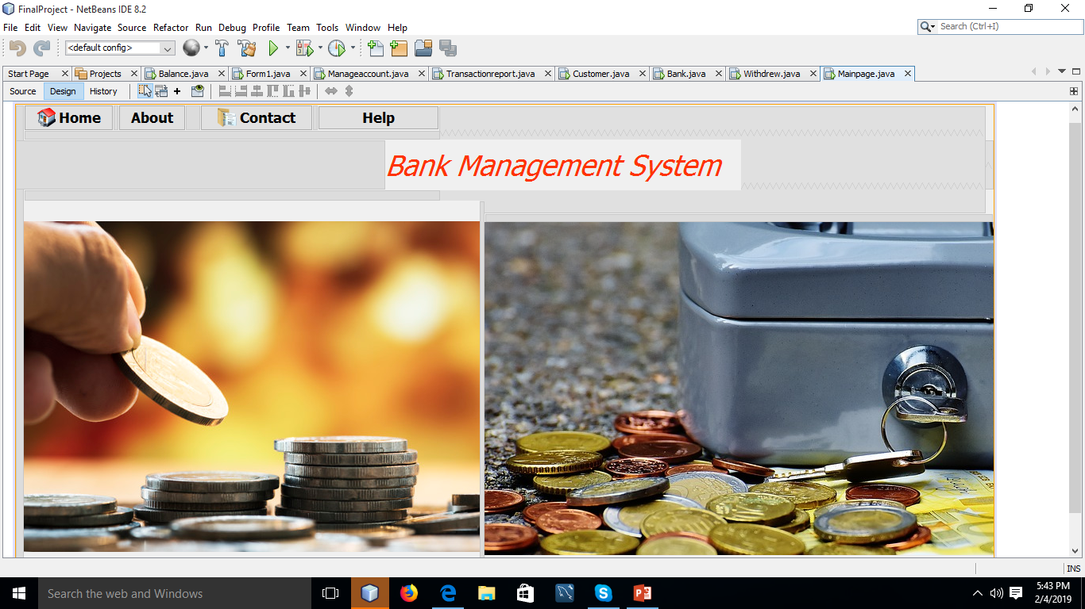

Slide 5
Project aim is to develop software for
Bank account management system

Slide 6
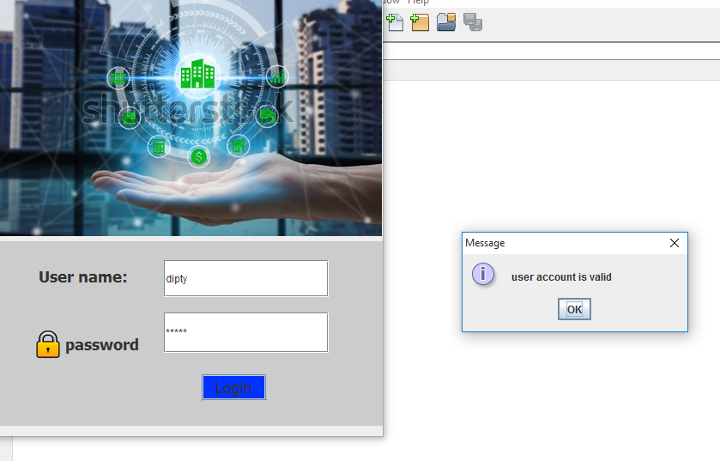

Slide 9

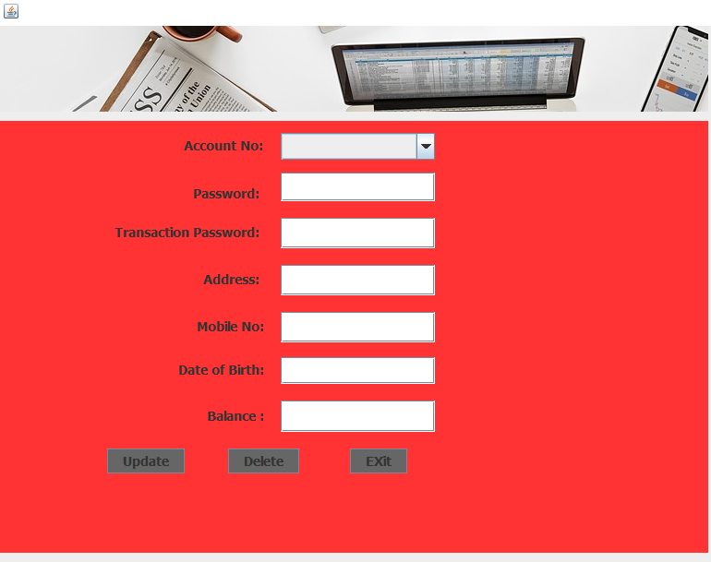

Slide 10
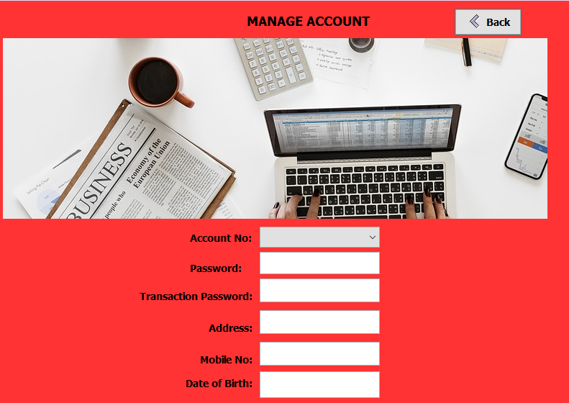

Slide 11
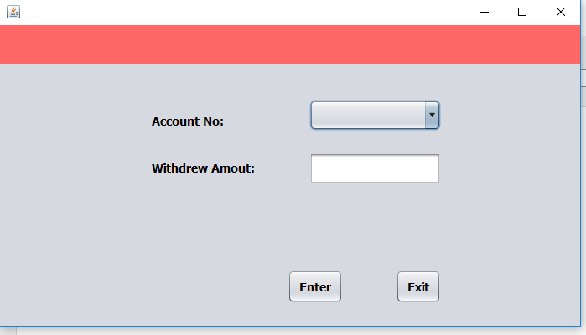
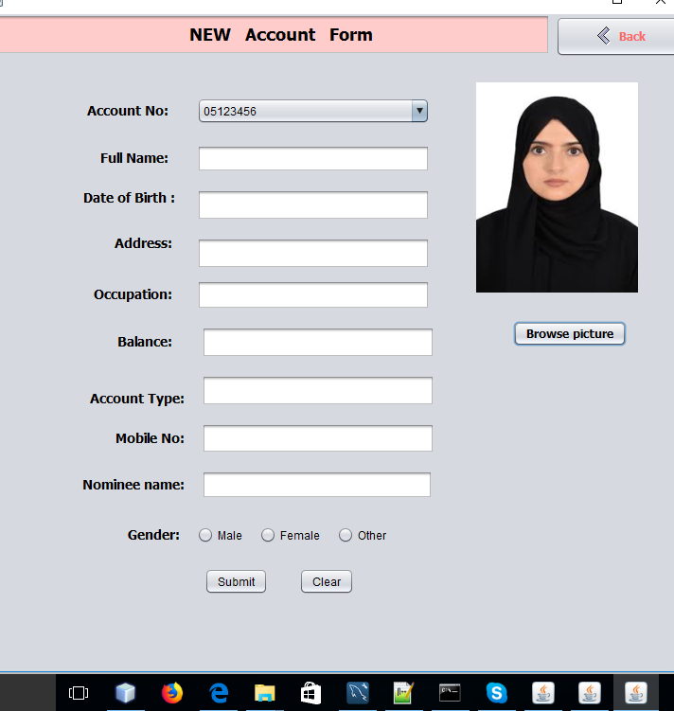
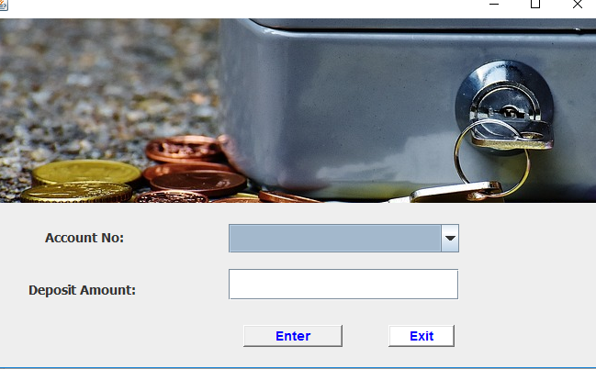

Slide 12
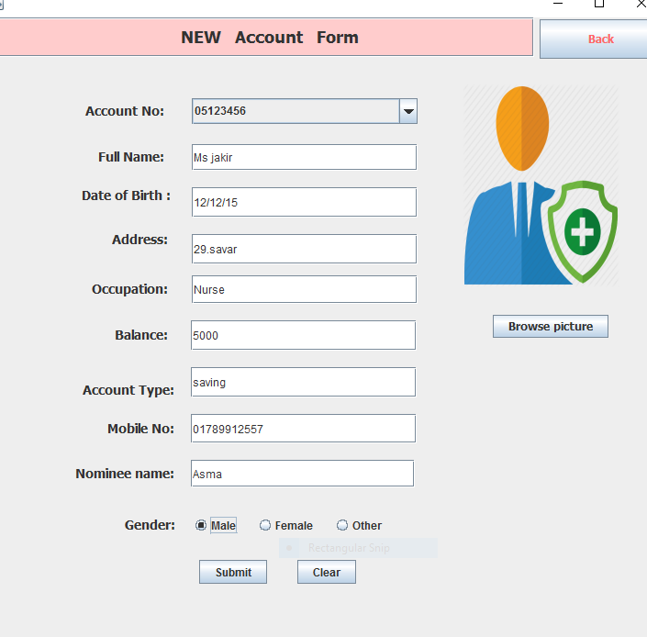

Slide 14
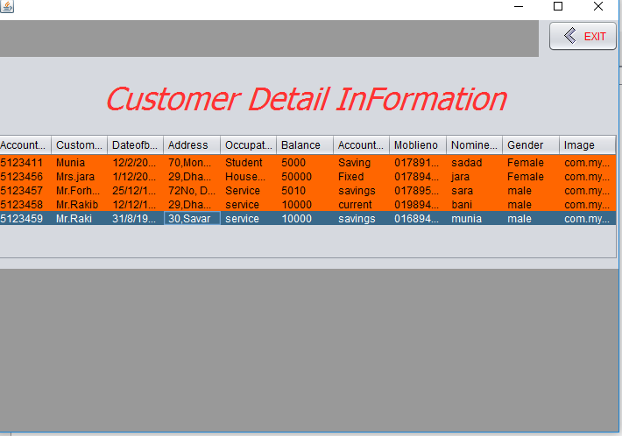

Slide 15
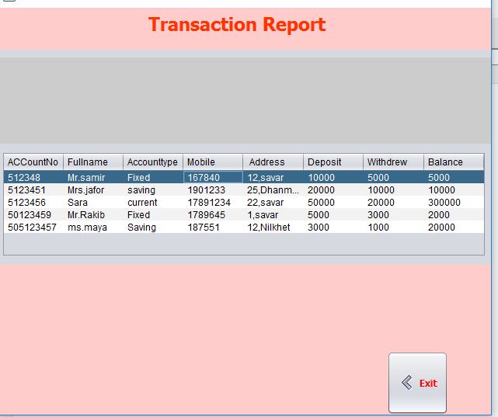

Slide 16
Future development
1)Loan sector will be create
2)Create customer free services
3)Customer login
4)Installment process
5)online services

Slide 17
Thank You

